Slide 1

Children’s Budget 2025

Slide 2

What is the Children’s Budget?
Tracks over 250 programs that invest in the needs of children
Calculates children’s share of total federal spending and analyzes trends in support for children in the budget over time
Conducts deep dives into important issue areas (e.g., health, nutrition, education) to offer a holistic overview of federal support for child well-being

Slide 3
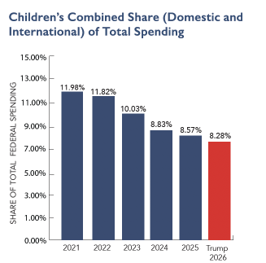
The share of federal spending on children fell for the fourth straight year
The share of federal spending on children fell in FY 2025 to just 8.57%.
This is a drop of more than a quarter since the all-time high of 11.98% in FY 2021.
Under the President’s Proposed FY 2026 Budget the share would fall to just 8.28%.

Slide 4
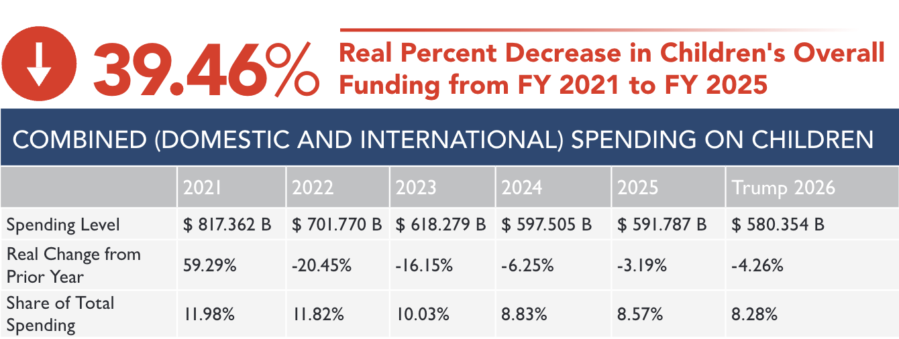
Children’s funding failed to keep up with inflation for the fourth straight year– falling by almost 40% since FY 2021

Slide 5
Spending on children internationally makes up just 0.09% of all federal spending in FY 2025

Slide 6
The President’s proposed budget would reduce spending on children internationally to just 0.03% of federal spending.

Slide 7
Inflation-adjusted trends by issue area
Adjusting for inflation, from 2021 to 2025:
Early childhood spending fell by 76.52%
Education spending on children fell by 35.83%
Health spending on children increased by 20.07%
Housing spending on children increased by 8.84%
Income support spending on children fell by 54.08%
Justice and child protection spending on kids fell by 12.06%
Nutrition spending on children fell by 40.69%
Training spending on children fell by 12.61%

Slide 8
The President’s proposed FY 2026 budget would cut discretionary spending by 23.66% adjusted for inflation
Children’s Share of Discretionary Spending would fall to just 5.81% under the President’s proposed FY 2026 Budget.
This is down nearly 60% since FY 2021.

Slide 9
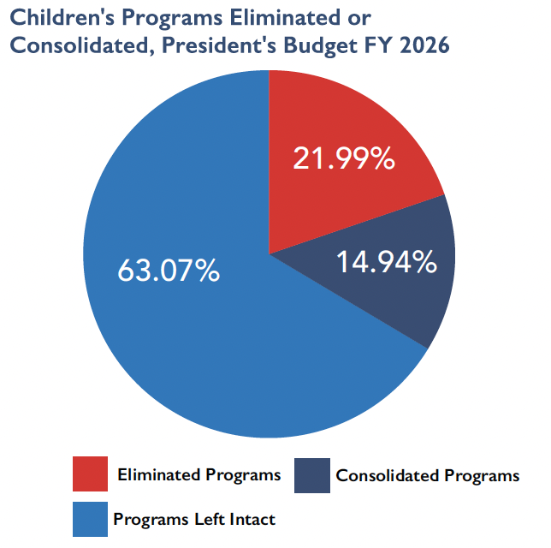
The President’s Budget would cut almost 100 children’s programs– nearly a third of all discretionary programs

Slide 10
The worst is yet to come… H.R. 1
Most of the harm to kids does not show up in these numbers.
The reconciliation package, H.R. 1, slashes spending on Medicaid and SNAP, two of the five largest programs for kids.
These cuts will only show up in future books and we do not know the precise cut imposed on kids.
H.R. 1 cuts $182.2 billion from Medicaid for children over the next decade and $80.4 billion from the children’s share of the Supplemental Nutrition Assistance program.
The effect of these cuts will become evident as H.R. 1's provisions kick in and will likely lower the already small share of federal spending on children.

Slide 11
Thanks!
Any questions?
You can find me at chrisb@firstfocus.org

