Slide 1

Federal Investment in Babies: A View from the States

Slide 2

What is Babies in the Budget?
Tracks nearly 150 programs that invest in the needs of children 0-3
Calculates babies’ share of total federal spending and analyzes government investment in babies over time
Dives deep into important issue areas (e.g., health, nutrition, early childhood) to offer a holistic overview of federal support for well-being of our youngest children

Slide 3
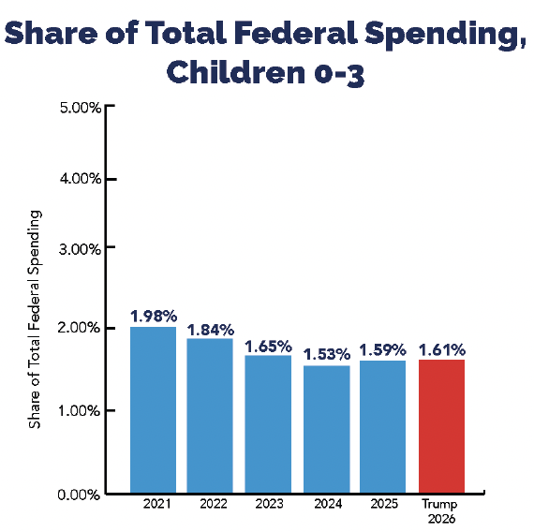
The share of federal spending on babies sits at just 1.59%
The share of federal spending on children sits at just 1.59% in FY 2025.
This is a drop of nearly 1/5th since the high of 1.98% in FY 2021.

Slide 4
Babies’ share trends by issue area
From FY 2021 to FY 2025 the share of spending on babies for:
  Early childhood fell by 69.50%
  Health increased by 47.71%
  Housing increased by 29.66%
  Income support fell by 45.14%
  Justice and child protection fell by 3.89%
  Nutrition spending fell by 4.29%

Slide 5
Biggest contributors to the decline in babies’ share since 2021
Phasing out of Economic Impact Payments that offered guaranteed additional income for all people
Loss of the Child Care Stabilization Fund
Decrease in the Child Care and Development Block Grant
Reduction in the increased Child Tax Credit for kids 0-6 and elimination of full refundability that guaranteed full CTC to low-income babies
Expiration of Emergency Allotments for SNAP

Slide 6
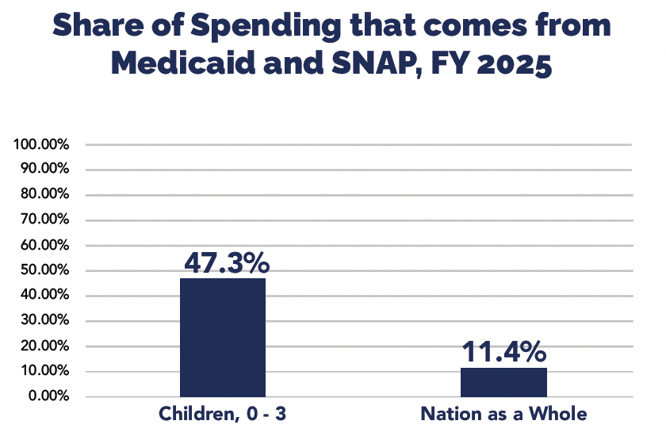
More bad news to come… H.R. 1
Most of the harm to babies does not show up in these numbers.
The reconciliation package, H.R. 1, slashes spending on Medicaid and SNAP, two of the five largest programs for babies — these alone make up 50% of all spending on babies!
These cuts will only show up in future reports and we do not know the precise magnitude of cuts on babies.

Slide 7
A view from the states
We estimate federal spending on babies for each state by:
  Collecting data for federal spending by state for 13 programs that cover more than 75% of federal spending on children under 3
  Estimating the share of spending for each of these programs going to children 0 to 3 for each state

Slide 8
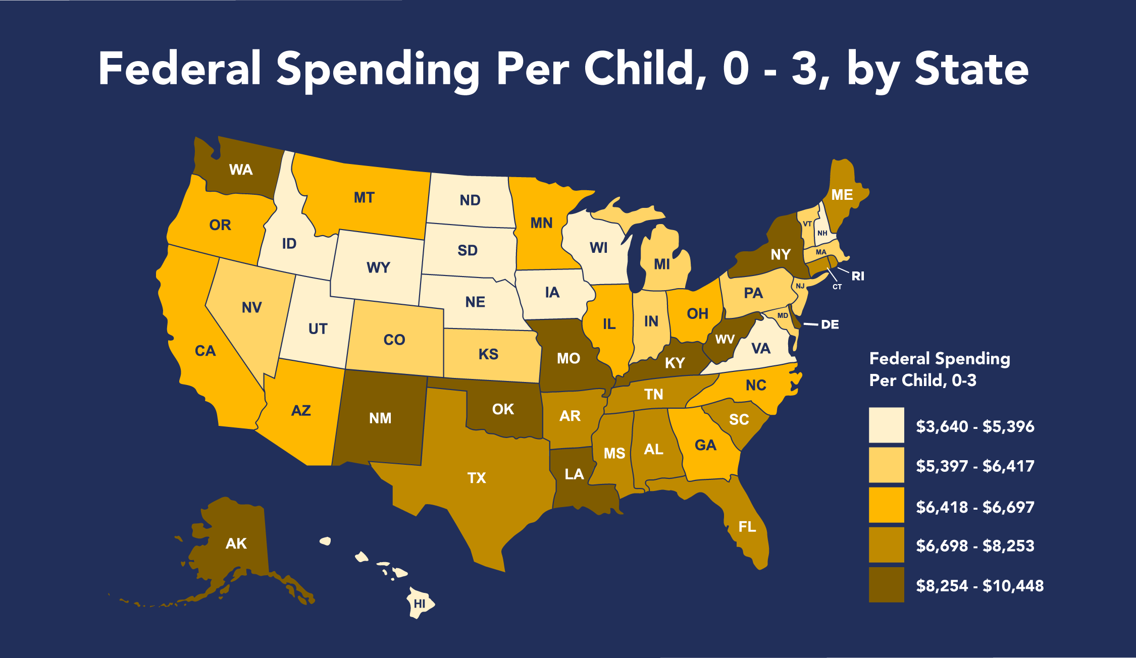
Mapping Federal Spending on Infants and Toddlers

Slide 9
Putting These Numbers in Context
Federal spending per baby in Utah (lowest state): $3,640
Federal spending per baby in Alaska (highest state): $10,448
Cost of raising a baby in the first year: approx. $20,000
Health costs associated with pregnancy, childbirth, and infant care: $20,416
Average annual Social Security Check: $24,852

Slide 10
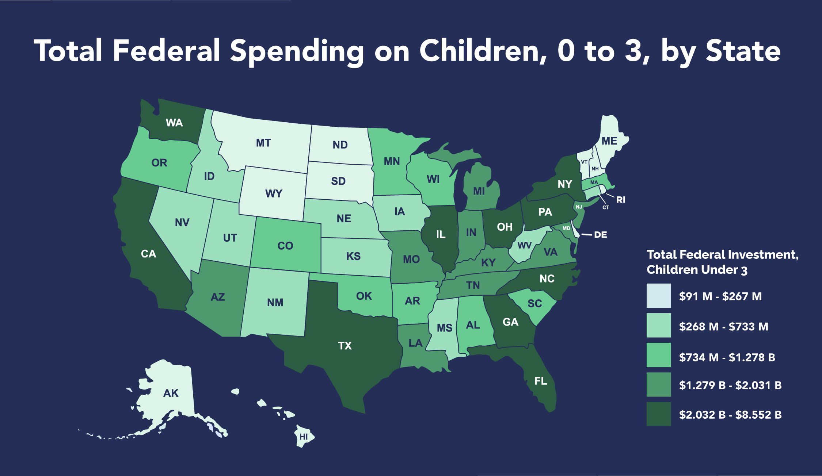
Mapping Federal Spending on Infants and Toddlers, Total

Slide 11
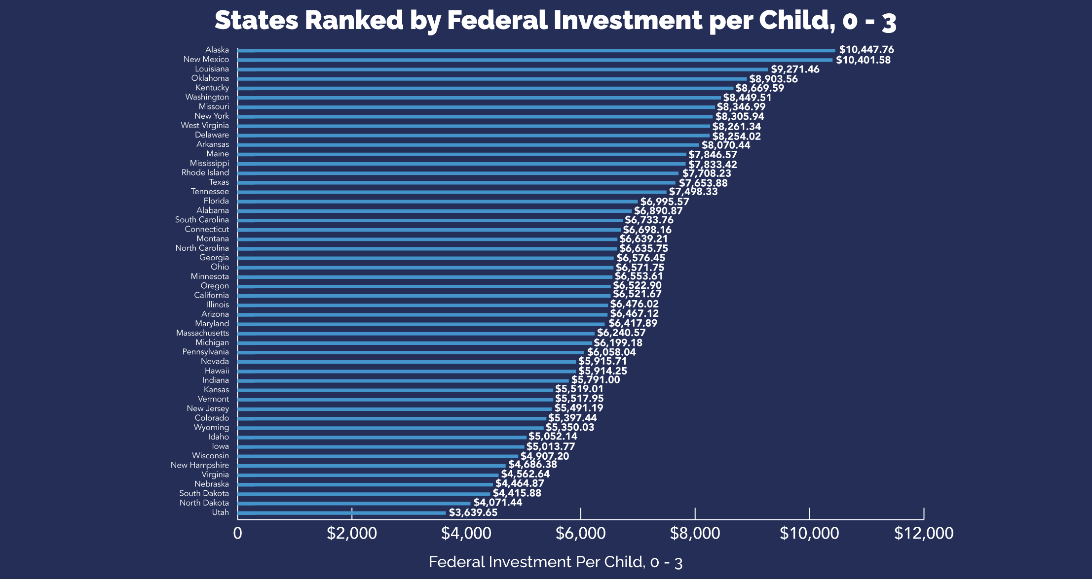
Annual federal spending per baby varies widely by state, ranging from just over $3,600 per baby (Utah) to more than $10,000 (Alaska).

Slide 12
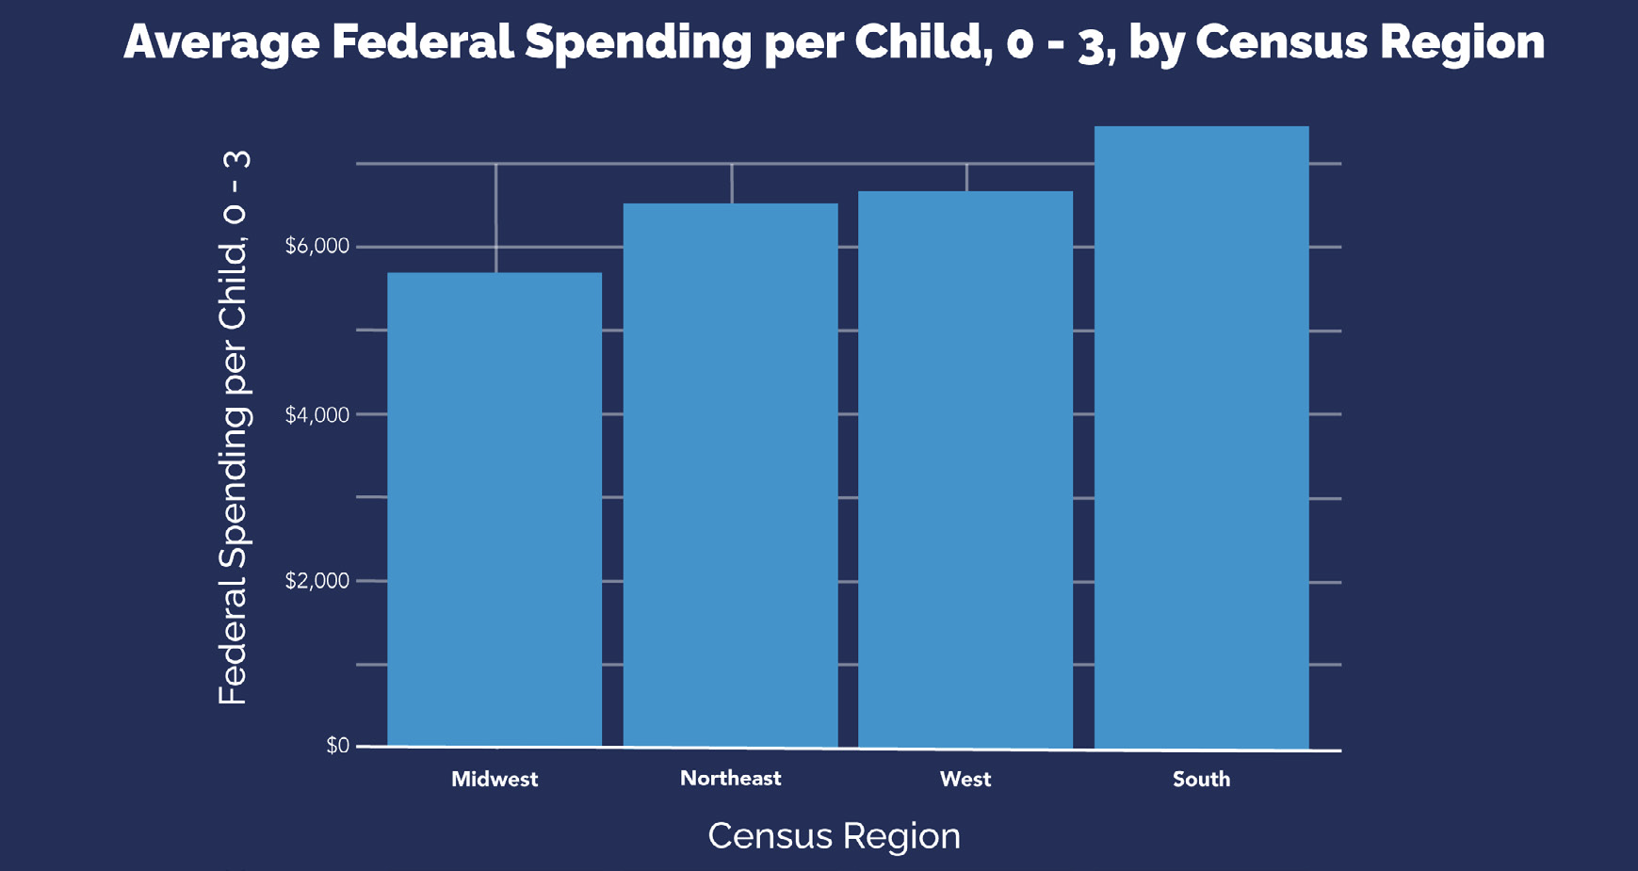
Southern states log the highest annual federal investment per child under 3 while investment is lowest in the Midwest.

Slide 13
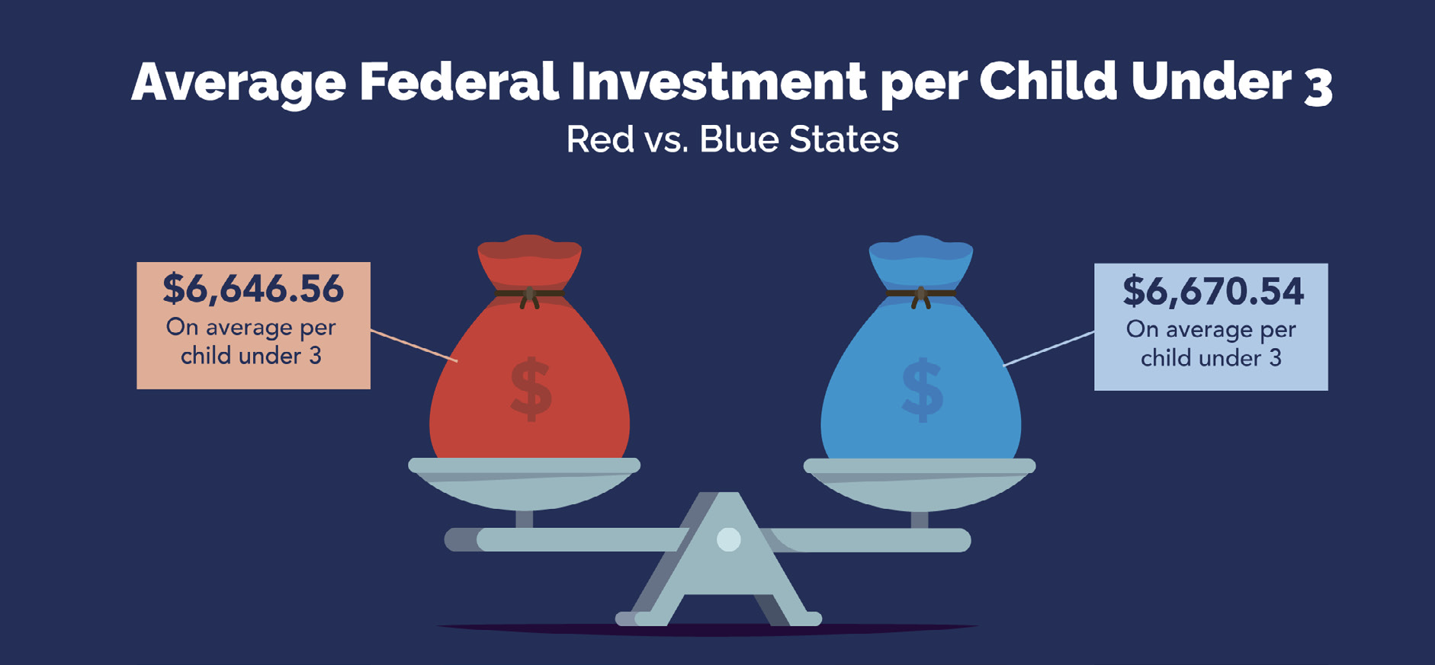
Federal support for babies and toddlers is comparable in red and blue states. The average spending per child under 3 for red and blue states is nearly identical.

Slide 14
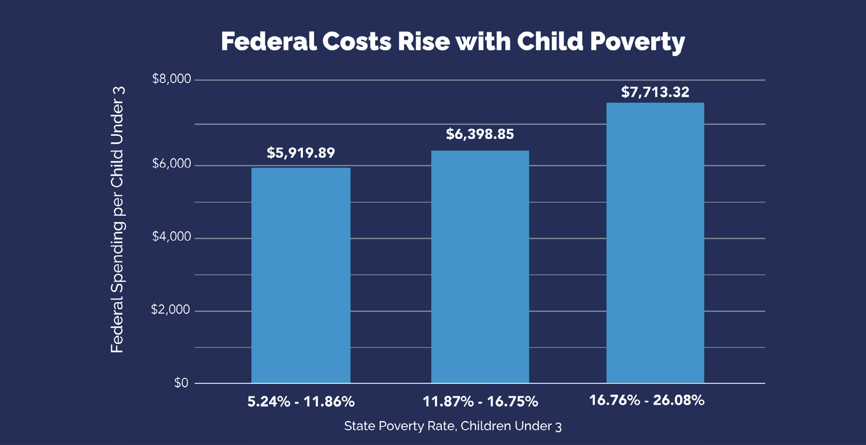
Federal spending on children under 3 largely tracks with need: states with higher baby poverty rates generally receive more federal support to address those and other needs.

Slide 15
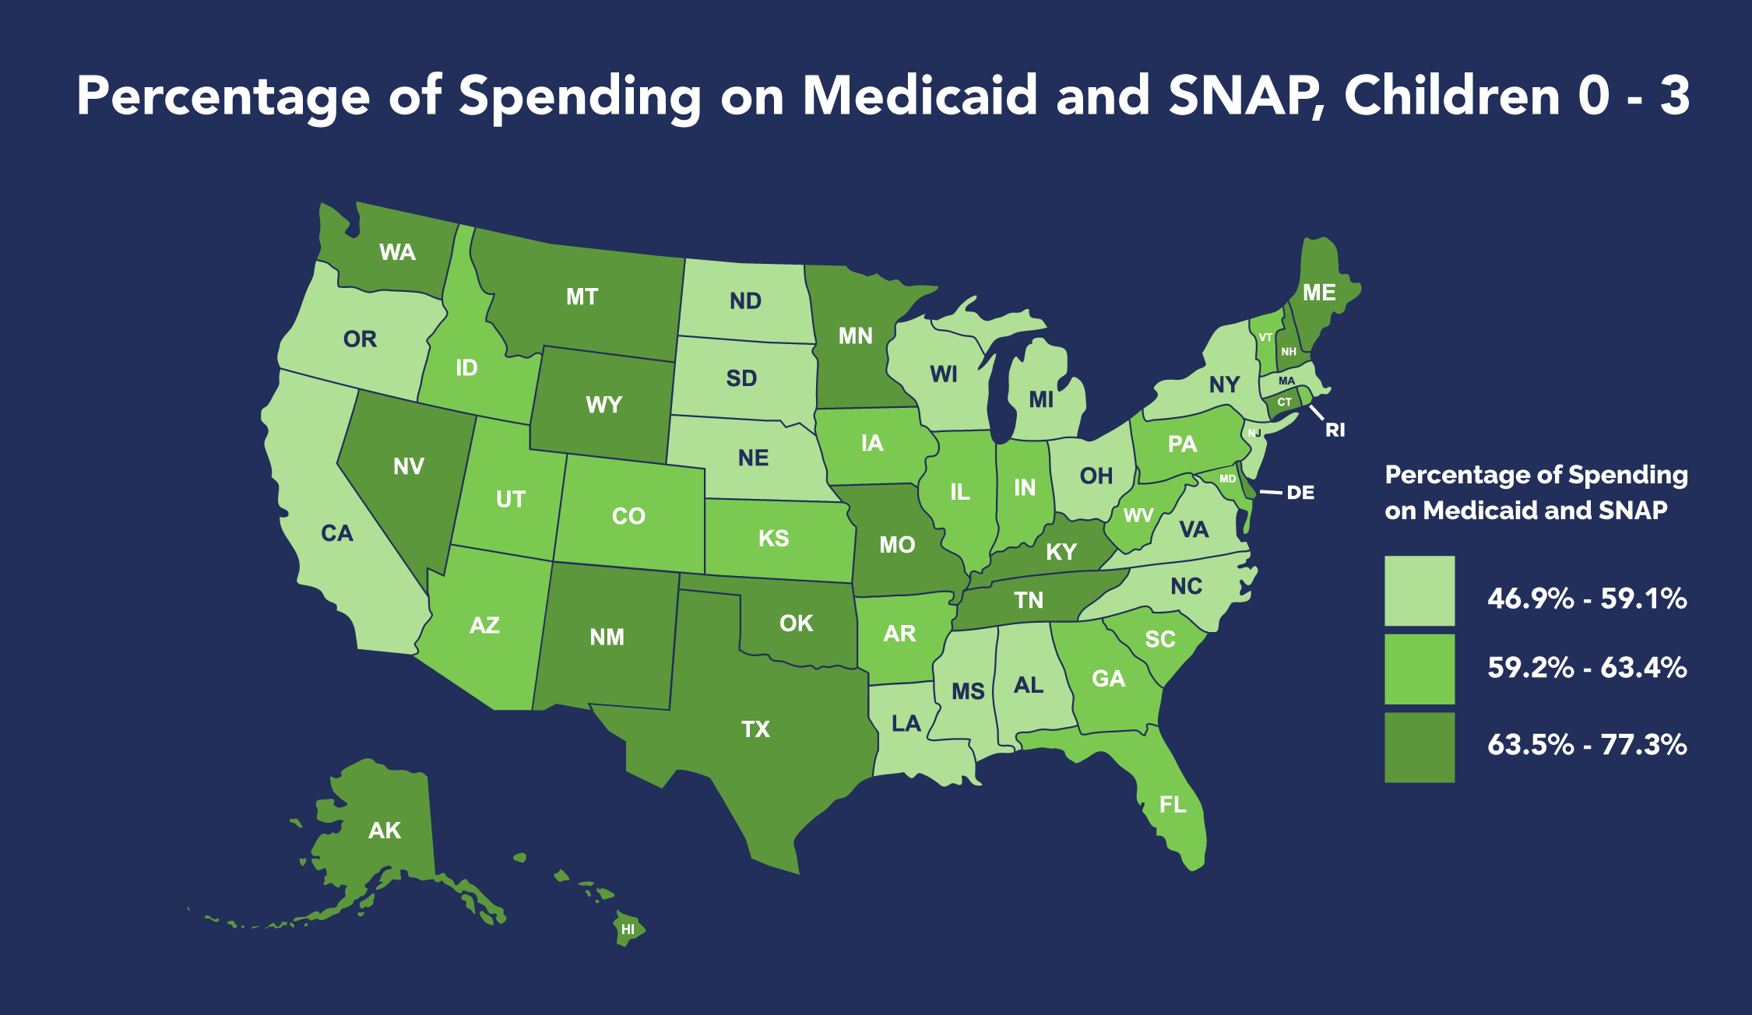
Medicaid and SNAP — which were cut by more than $1 trillion in H.R. 1 — account for the majority of program spending in 49 of 50 states

Slide 16
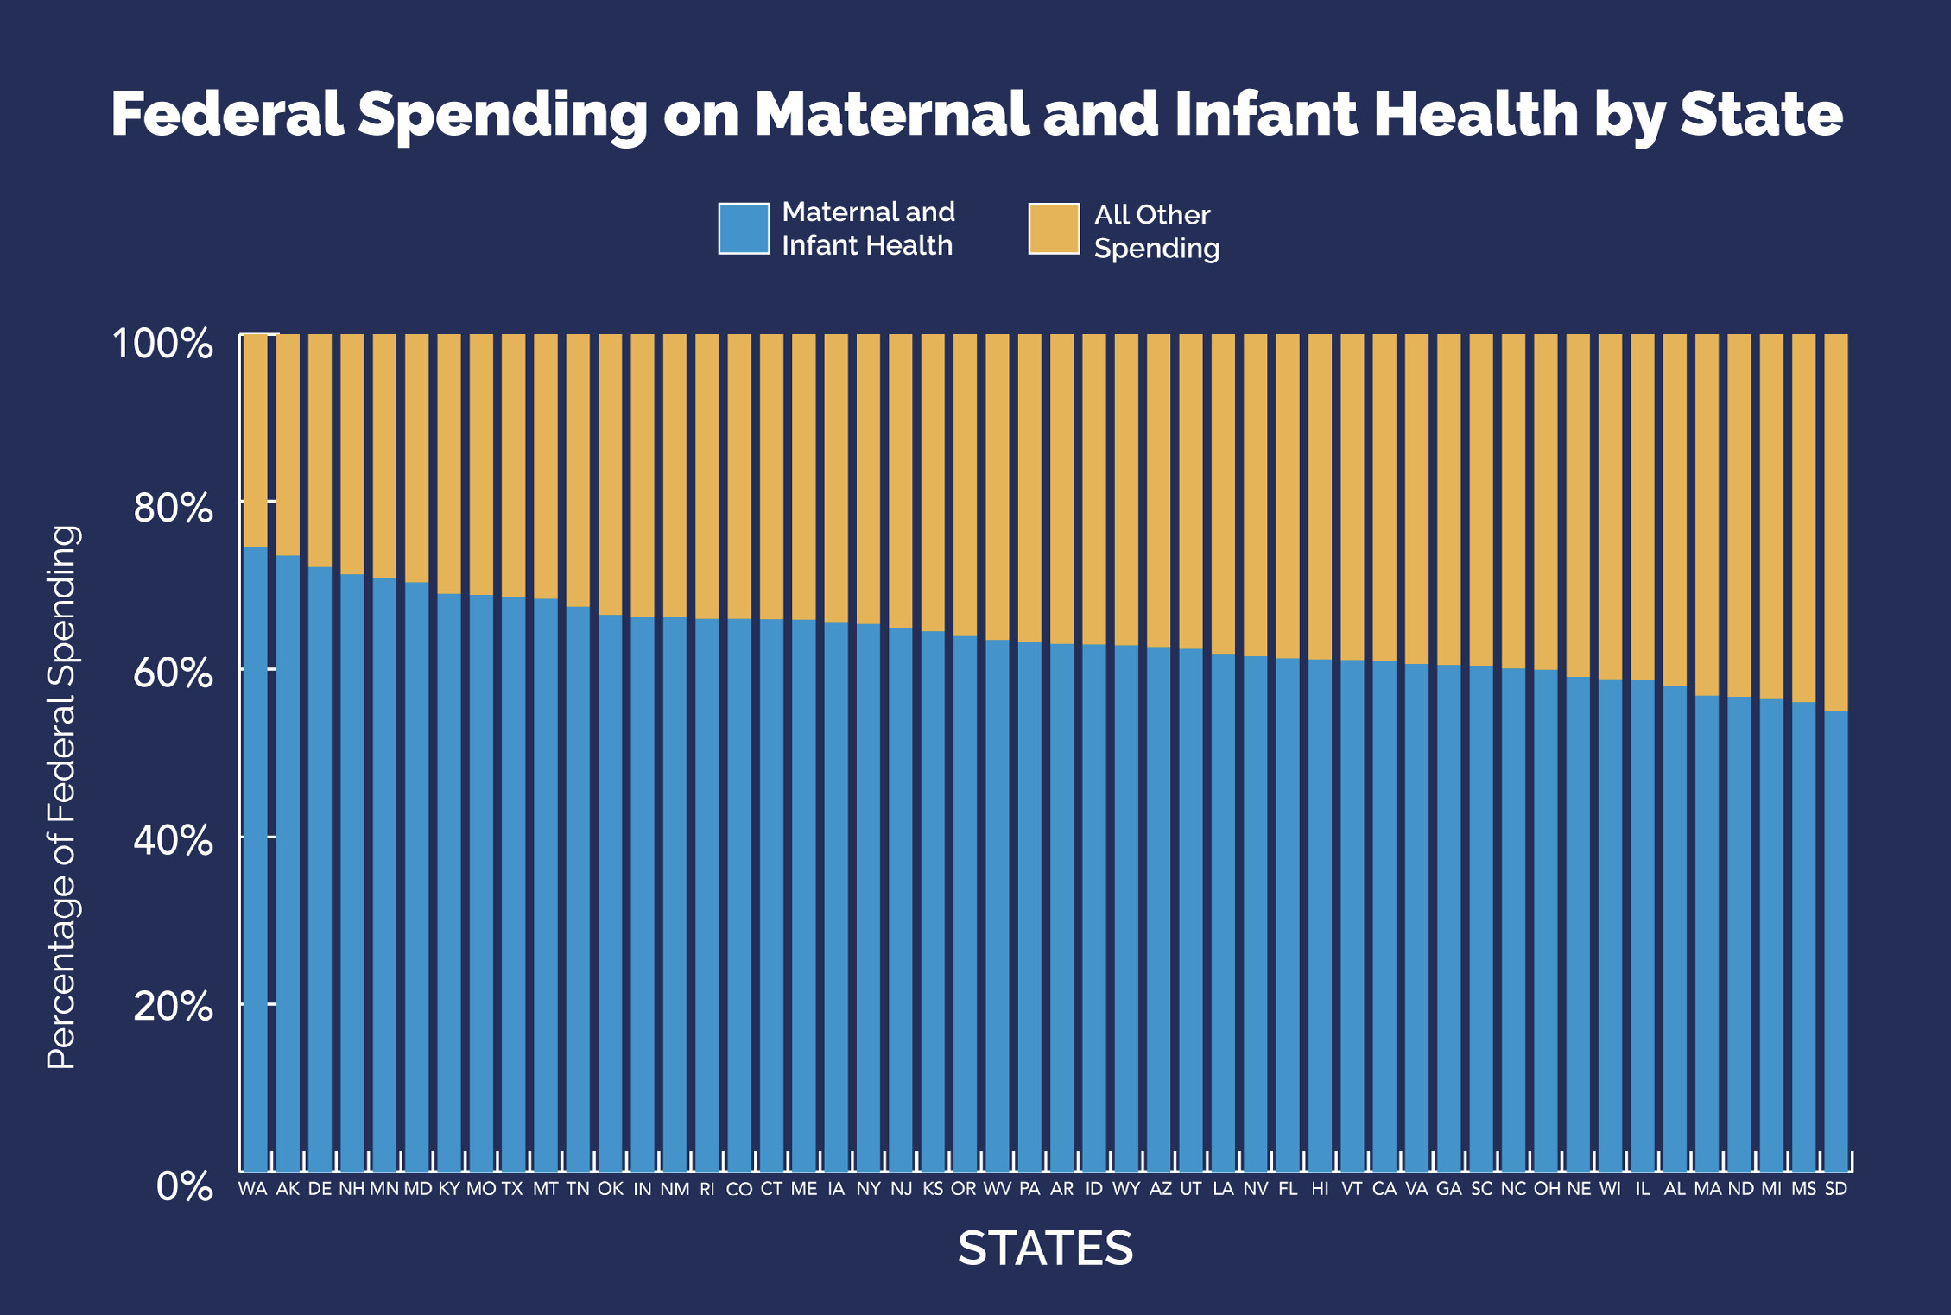
Maternal and infant health programs including Medicaid, CHIP, WIC, and Healthy Start make up at least half of all federal spending on children 0 - 3 for every state — from 55.0% in South Dakota to 74.6% in Washington.

Slide 17
Thanks!
Any questions?
You can find me at chrisb@firstfocus.org

